Slide 1
Week-11
COSC 32001 Computer Vision
Noopa Jagadeesh
Date: 28 March 2024

Slide 2
Recap
Cascade classifiers from OpenCV
Face Recognition
Feature Detection
Feature Matching
Image Similarity

Slide 3
Agenda
Student demo: Assignment#4
Image Histogram
Histogram Equalization
Histogram and Back Projection
Object Tracking

Slide 4

Critical Path

Slide 5
Image Histogram
Notes:
hydranet

Slide 6
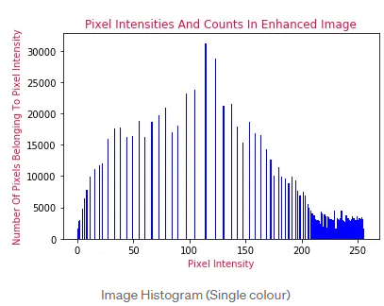

Image Histogram
Image histogram shows the distribution of pixel intensity. It is a graphical representation of the number of pixels in an image as a function of their intensity.
By understanding the histogram, you can gain information about the image’s contrast, brightness, and overall tonal distribution.
By understanding and applying histogram analysis techniques, we are enabled to enhance image quality, perform thresholding operations, analyze colour compositions, extract useful features, and visualize and understand images more effectively.
To visualize the distribution of colour values within the image, we can create a histogram. This histogram displays the number of pixels having the same colour value. By comparing the heights of the bars, we can easily identify which colour values are more prominent or occur more frequently in the image. This graphical representation provides valuable insights into the overall colour composition and distribution of an image.

Slide 7
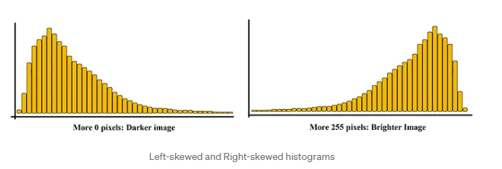
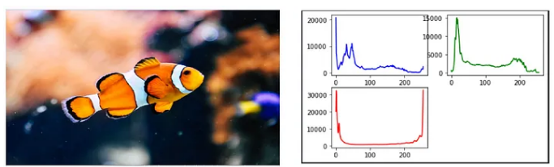
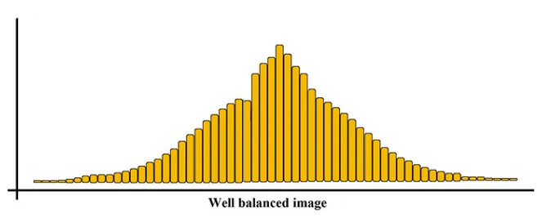
Image Histogram
The image must contain more Black pixels if the histogram is shifted to the left (left-skewed) and the image must contain more White pixels if our histogram is shifted to the right (right-skewed).
More black → darker image
More white → brighter image

Slide 8
Histogram Equalization

Slide 9
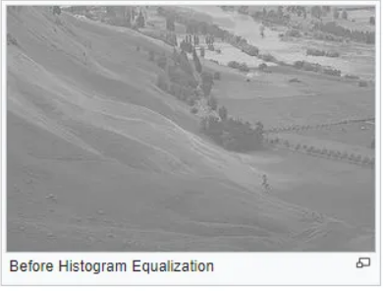
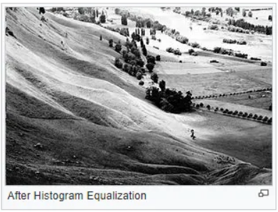
Histogram Equalization
Histogram equalization is a method to process images in order to adjust the contrast of an image by modifying the intensity distribution of the histogram.
It accomplishes this by effectively spreading out the most frequent intensity values, i.e. stretching out the intensity range of the image. This method usually increases the global contrast of images when its usable data is represented by close contrast values. This allows for areas of lower local contrast to gain a higher contrast.

Slide 10


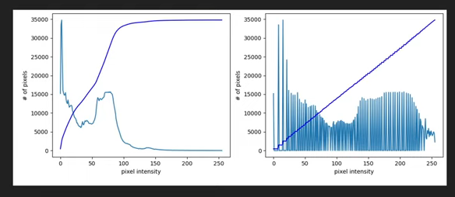
Histogram Equalization
Histogram Equalization is a method of redistributing the pixel intensity so that all the intensities are more or less equally distributed.
In the first plot all the
pixels are tend to be in the dark region that's why the first image is
dark.
In the second plot it is a more evenly distributed curve.
The CDF plot is actually what tells us about it and we can see it went from ramping up quickly to leveling off in the first graph whereas a linear ramp which in graph two, means that they're more or less equally distributed.

Slide 11
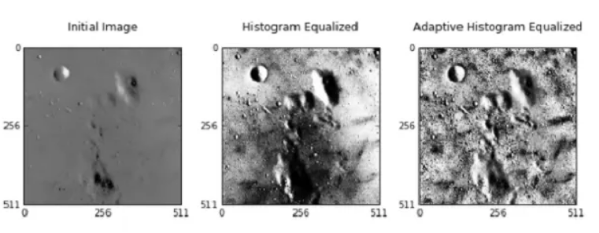
Adaptive Histogram Equalization
Adaptive Histogram Equalization differs from ordinary histogram equalization in the respect that the adaptive method computes several histograms, each corresponding to a distinct section of the image, and uses them to redistribute the lightness values of the image. It is therefore suitable for improving the local contrast and enhancing the definitions of edges in each region of an image.

Slide 12
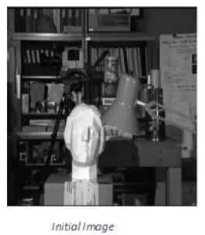
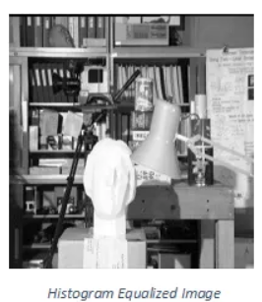
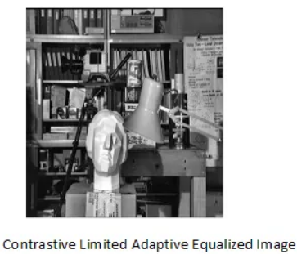
Contrastive Limited Adaptive Equalization
Contrast Limited AHE (CLAHE) differs from adaptive histogram equalization in its contrast limiting. In the case of CLAHE, the contrast limiting procedure is applied to each neighborhood from which a transformation function is derived. CLAHE was developed to prevent the over amplification of noise that adaptive histogram equalization can give rise to.

Slide 13
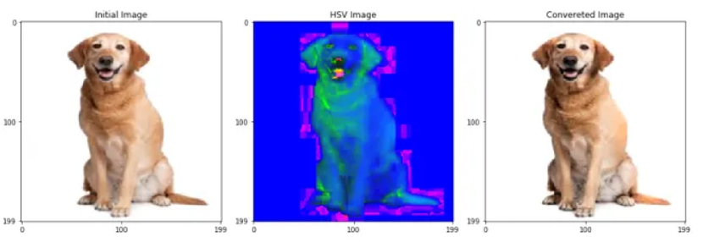
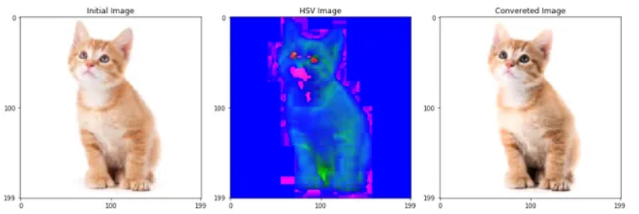
Contrastive Limited Adaptive Equalization

Slide 14
Histogram and Back Projection

Slide 15
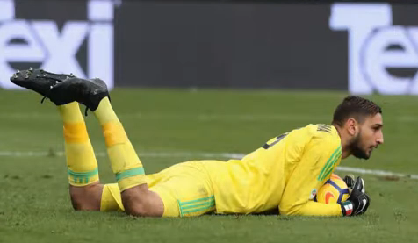
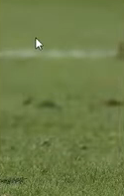
Histogram and Back Projection
Back Projection is a way of recording how well the pixels of a given image fit the distribution of pixels in a histogram model. For Back Projection, you calculate the histogram model of a feature and then use it to find this feature in an image.
Back projection method is going to be useful where we're going to see video analysis and can-shift algorithm to
track object.
Image which is just the ground of a football pitch we are going to calculate
a histogram.
We take a second image and find in this image all the parts that have the same histogram of this one in the previous image.

Slide 16
Object Tracking
Object tracking is a fundamental task in computer vision that involves the continuous monitoring of objects’ positions and trajectories in a video sequence.
Object detection focuses on identifying objects within an image or video frame, typically by drawing bounding boxes around them. Object tracking, on the other hand, involves the sequential estimation of an object’s position, size, and orientation across multiple frames. Tracking algorithms aim to maintain the identity of the object over time, enabling its continuous monitoring.
Object tracking is the process of:
Taking an initial set of object detections (such as an input set of bounding box coordinates)
Creating a unique ID for each of the initial detections
And then tracking each of the objects as they move around frames in a video, maintaining the assignment of unique IDs

Slide 17
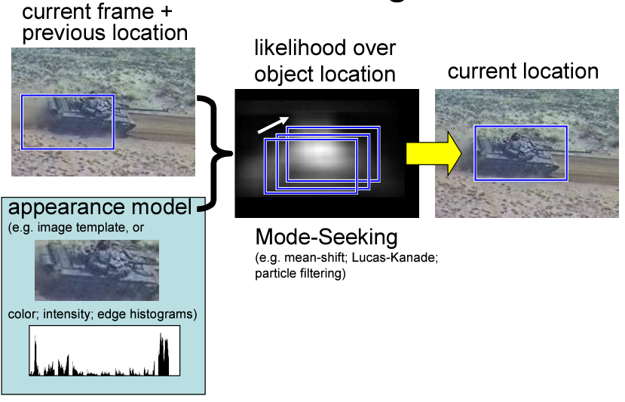
Appearance Based Tracking

Slide 18
Object Tracking
Object Tracking with Mean Shift
The mean-shift algorithm is an efficient approach to tracking objects whose appearance is defined by histograms. (not limited to only color).
Mean shift algorithm, which is responsible for finding the centre of the probability distribution of the object to track.
Object tracking with Camshift
The CAMShift (Continuously Adaptive Mean Shift) algorithm is a colour-based object tracking method introduced by Gary Bradski in 1998 to reduce computational complexity of the methods used during that period.
The main difference is that CAMShift adjusts itself to the search window size, for example when object sizes are changing as they move closer to or farther from the camera.

Slide 19
Disclaimer
Due to nature of the course, various materials have compiled from different open source resources with some moderation. I sincerely acknowledge their hard work and contribution

Slide 20


